Slide 1
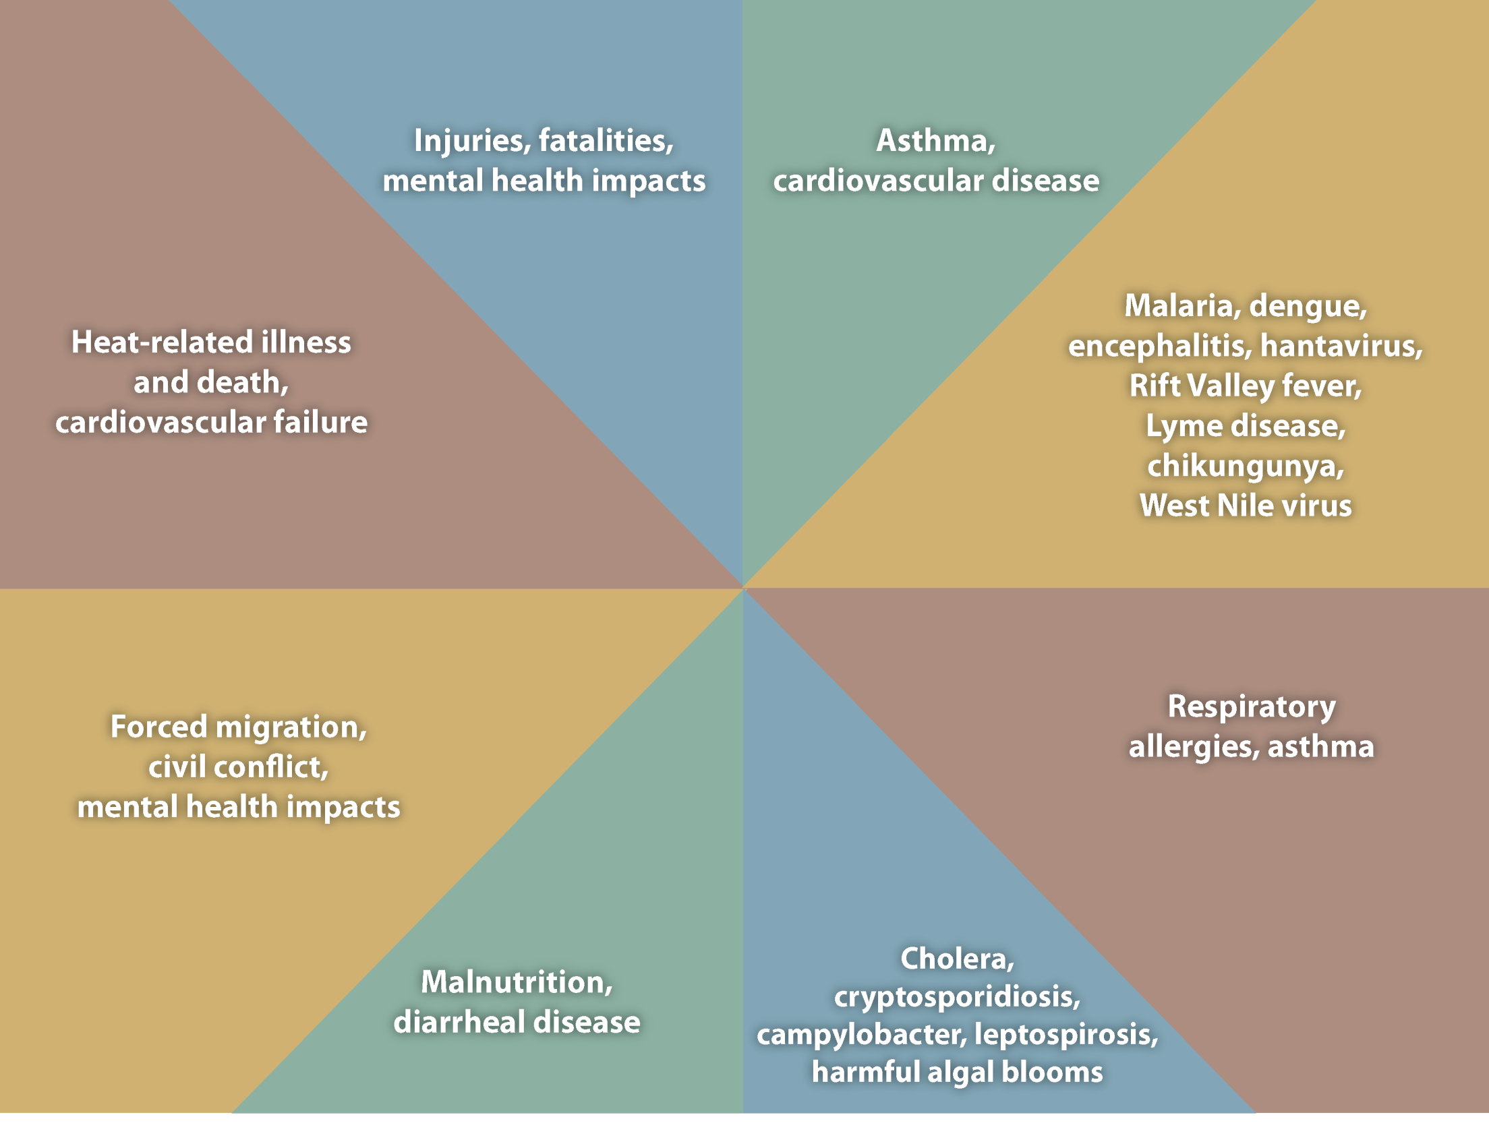
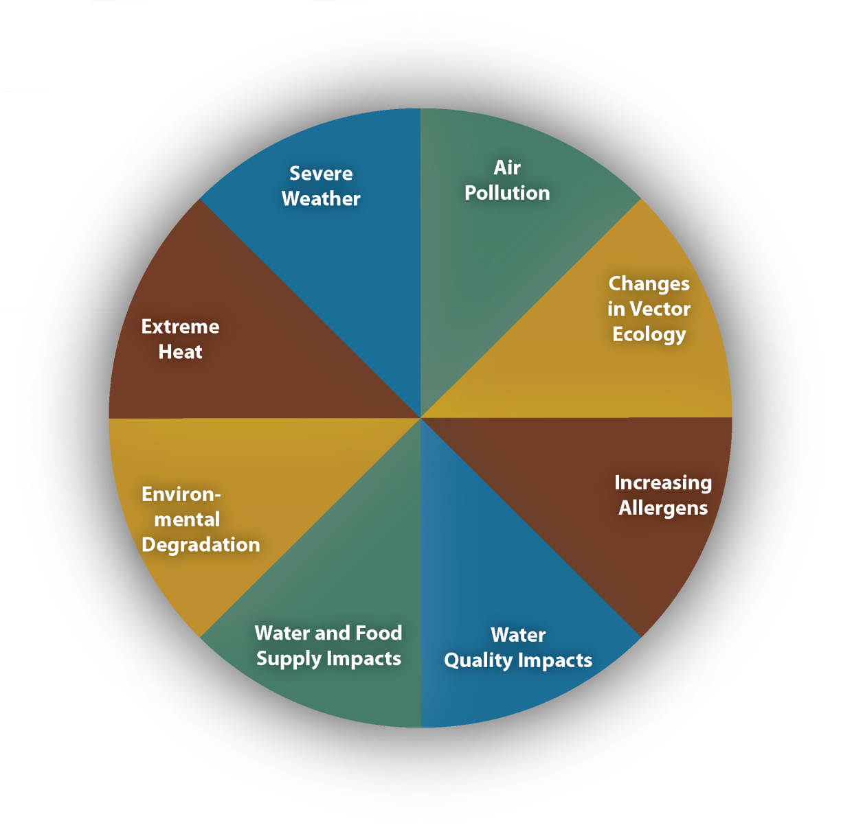
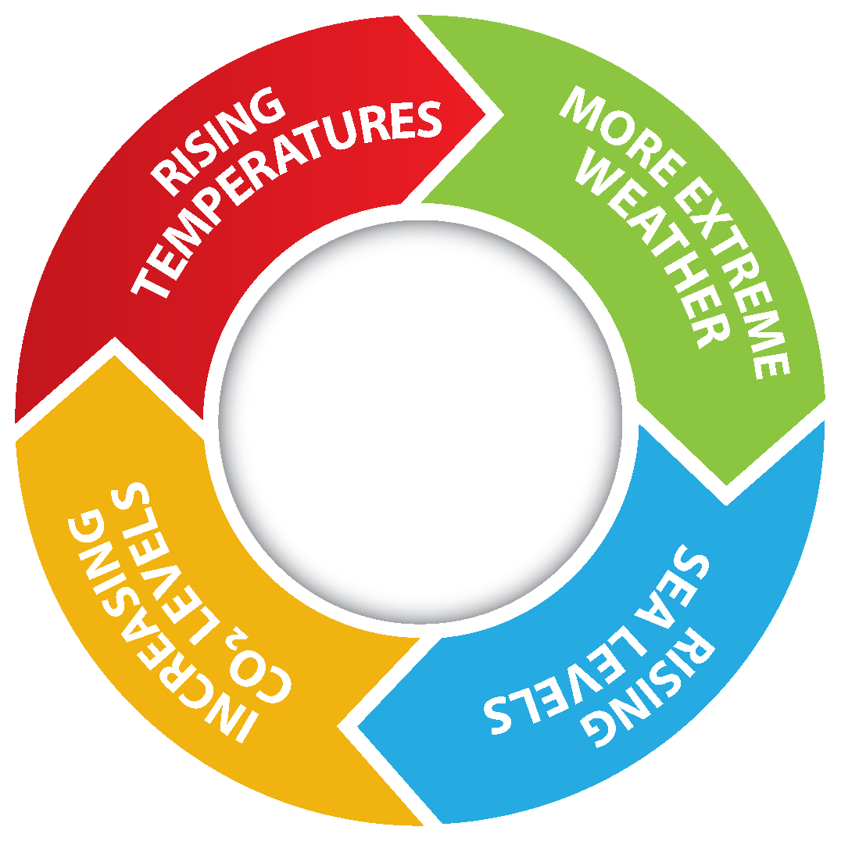
Notes:
Climate change impacts a wide-range of health outcomes. This slide illustrates the most significant climate change impacts (rising temperatures, more extreme weather, rising sea levels, and increasing carbon dioxide levels), their effect on exposures, and the subsequent health outcomes that can result from these changes in exposures.

